Slide 1
Re-Imagining the Future
Janie McManus
Assistant Director, Education Scotland

Slide 2
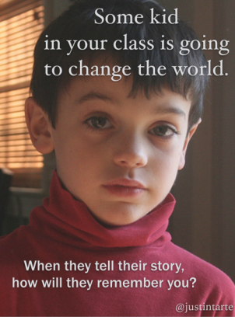
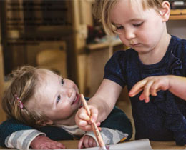
“Mankind owes to children the best it has to give. Their life is fragile. If they are to have a tomorrow their needs must be met today. Many things can wait but not the children”
Gabriela Mistral

Slide 3
“Be rigorous about the gaps to be closed and pursue relentlessly “ closing the gap” and “raising the bar simultaneously”
Improving Schools in Scotland: An OECD Perspective, 2015

Slide 4

The vision
Excellence through raising attainment:
ensuring that every child achieves the highest standards in literacy and numeracy, set out within Curriculum for Excellence levels, and the right range of skills, qualifications and achievements to allow them to succeed; and
Achieving equity: ensuring every child has the same opportunity to succeed, with a particular focus on closing the poverty-related attainment gap.

Slide 5
Excellence and Equity
Raising attainment (universal)
and
Closing the gap (selective intervention)

Slide 6
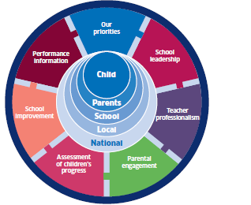
National Improvement Framework
Our Priorities
Improvement in attainment, particularly in literacy and numeracy;
Closing the attainment gap between the most and least disadvantaged children;
Improvement in children and young people’s health and wellbeing; and
Improvement in employability skills and sustained, positive school leaver destinations for all young people.

Slide 7

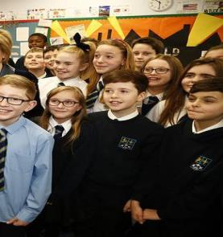
Achieving equity: ensuring every child has the same opportunity to succeed, with a particular focus on closing the poverty-related attainment gap.

Slide 8
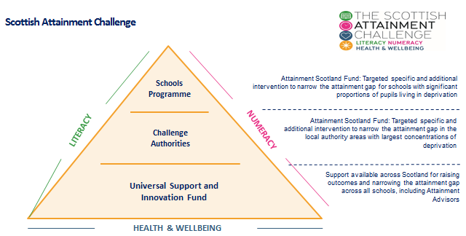

Slide 9

Support practitioners and school leaders at all levels to:
ensure educational outcomes for all learners are improving;
address the impact of inequity on wellbeing, learning and achievement;
consistently deliver high-quality learning experiences;
embed progression in skills for learning, life and work from 3-18;
further strengthen school leadership at all levels;
improve the quality and impact of career-long professional learning;
extend and deepen partnerships to improve outcomes for all learners;
increase learning for sustainability; and
tackle unnecessary bureaucracy.

Slide 10
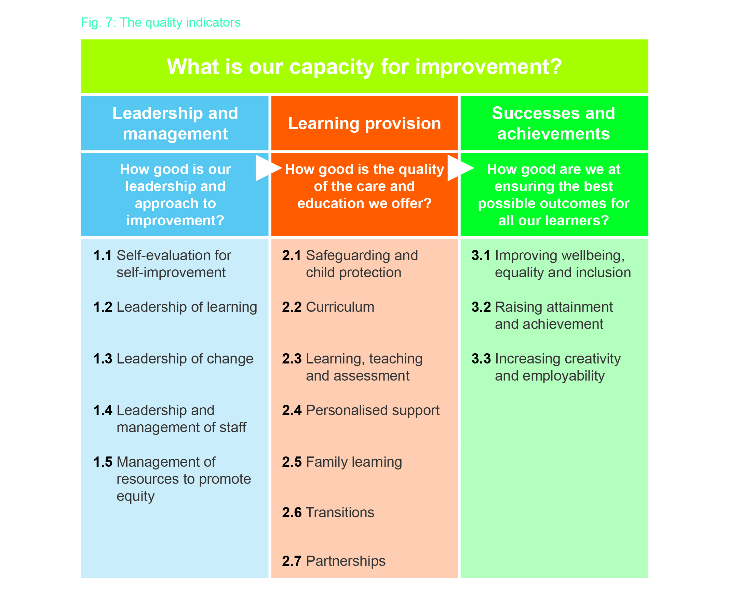

Slide 11


Slide 12
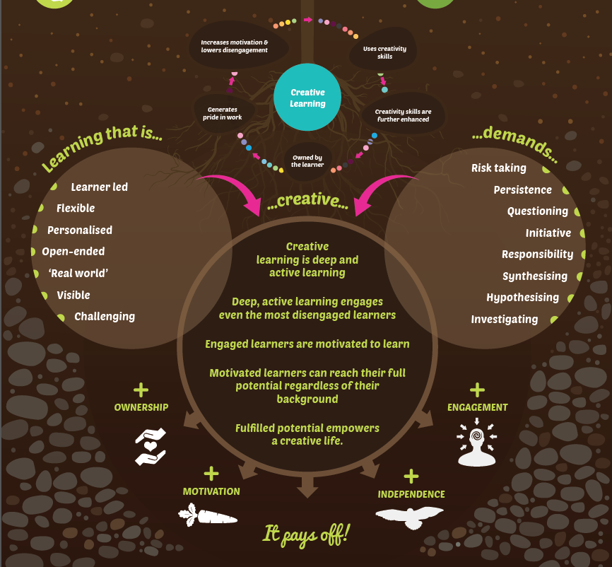

Slide 13

Are we able to follow our own motivations?
Is everything that can happen, happening in Curriculum for Excellence?
“Practitioners are the key.... The quality of learning and teaching in every setting – and the inspiration, challenge and enjoyment which can come from practitioners’ enthusiasm and commitment – will be critical to achieving our aspirations for all young people.”
Building The Curriculum 1

Slide 14
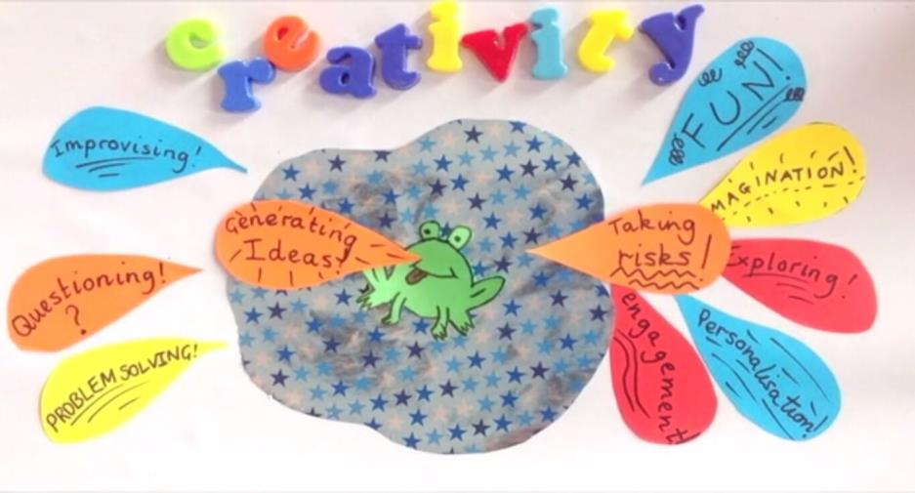
Creativity is a process which generates ideas that have value to the individual. It involves looking at familiar things with a fresh eye, examining problems with an open mind, making connections, learning from mistakes and using imagination to explore new possibilities.

Slide 15
creative learners
Motivated to explore and challenge assumptions
Taking ownership of their own learning
Appreciating issues from different perspectives
Using their imagination to explore ideas
Asking questions
Identifying problems
Seeking and justifying solutions
Transfer their creativity skills to new contexts

Slide 16

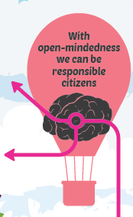



Slide 17
creative practitioners
Plan activities with a strong element of personalisation and choice
Give learners more responsibility for learning
Make learning activities more open ended
Provide effective coaching support to learners as they develop their ideas
Work in partnership with other organisations
Making learning interesting and engaging
Focus self-evaluation on creativity skills
Access or create effective collaborative networks

Slide 18
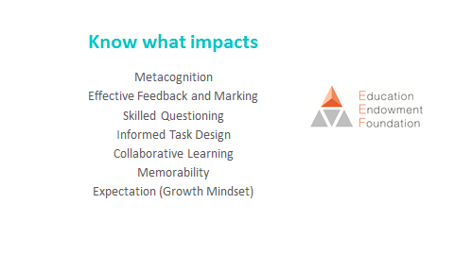

Slide 19

The importance of aspirations
the ability to
dream and set goals
for the future,
while being inspired
in the present
to reach those dreams.

Slide 20
An evaluation of excellent means that
This aspect of the school’s work is outstanding and sector-leading. The experiences and achievements of all children and young people are of a very high quality. An evaluation of excellent represents an outstanding standard of provision which exemplifies very best practice based on achieving equity and inclusion and a deep professional understanding which is being shared beyond the school to support system-wide improvement. It implies that very high levels of performance are sustainable and will be maintained.”

Slide 21

Create conditions which support innovation, creativity and enquiry.
Ensure curriculum rationale and design takes very good account of creativity.
Emphasise creativity in a progressive way across all areas of learning.
Develop partnership working to improve learning.
Use skilled questioning and engagement to promote curiosity, independence and confidence.
Regularly enable higher-order thinking skills in all learners.
Ensure children take increasing responsibility as they become more independent in their learning.

Slide 22
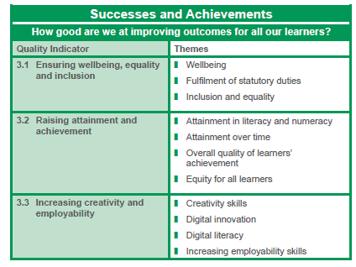
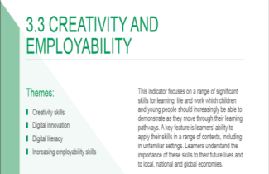
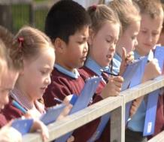
Level 5 illustration based on each theme
Features of highly-effective practice
Challenge questions

Slide 23
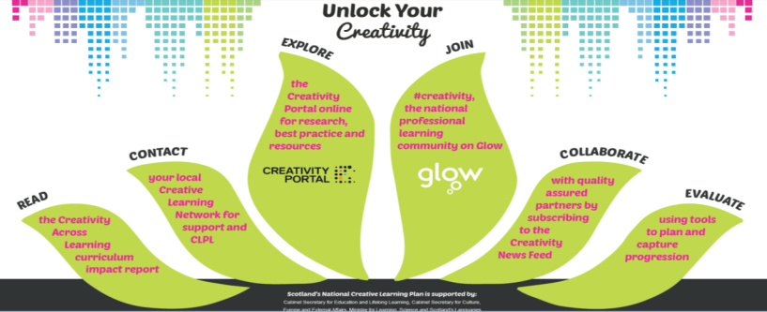


Slide 24
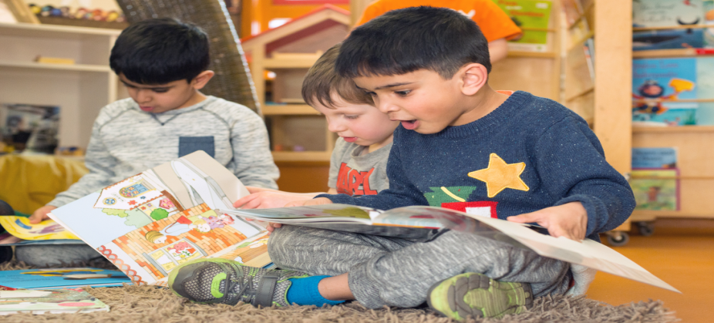
Defining problems
Researching productively
Drawing on previous knowledge
Exploring multiple viewpoints
Being bold and innovative
Applying discipline and resilience
Evaluating impact and success of solutions
Identifying next steps

Slide 25


Slide 26

Thank you
@janieamcmanus
Transforming lives through learning

